Slide 1
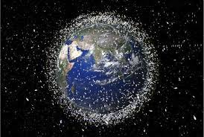
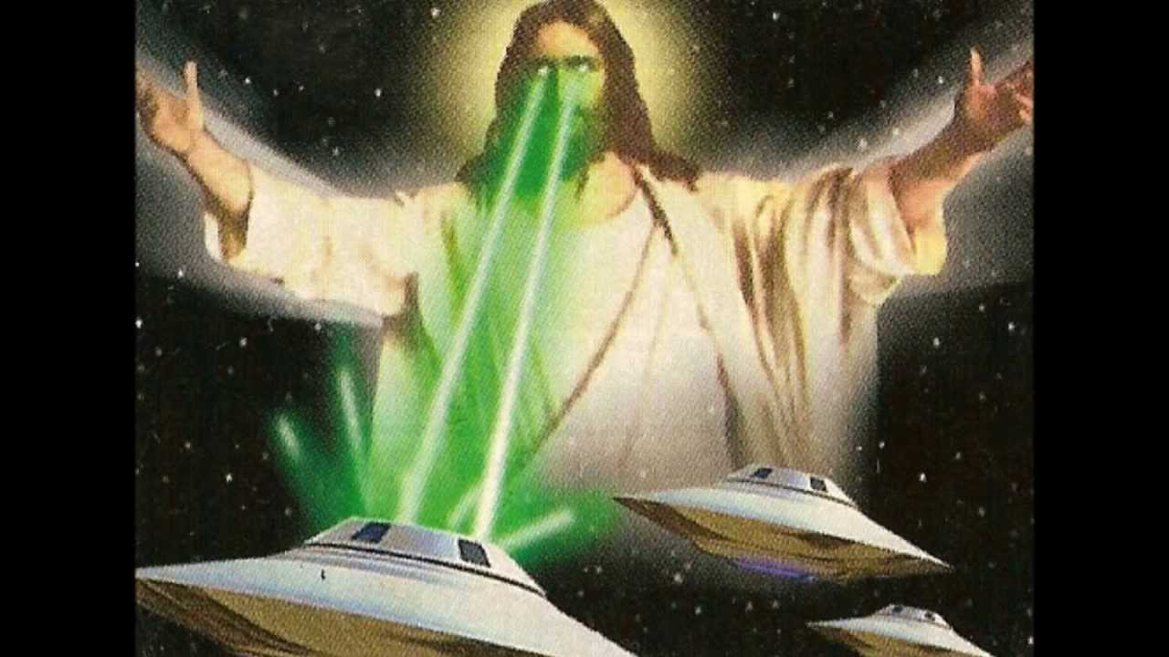
World Background
The Planet Gonk. Under a tyranical rule desperate for salvation from their overlords, with poor living conditions in slums and little food to go around the gonks are dying from sickness and starvation.
The game world will be based on the planet gonk and in the surrounding orbits.
These orbits area a dangerous place for anyone to venture into with the tyranical rule of the planet gonk.
This becomes more dangerous with the swirling rocks and debree that is in orbit making it a deathtrap.

Slide 2
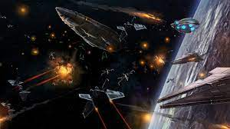
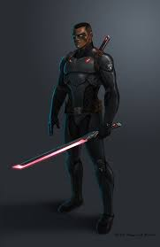
Pillars of Gameplay
The game will have zero-gravity parkour mechanics that feel floatly and satisfying to use
The game will be centred around a complex space stealth machanic that focus's on the use of floating space debree to hide behind
The game will also have large scale space fights with star wars type of ship combat using blasters and quick and precise movemnts
There will be a chainkill mechanic that uses the quick movements of space to jump from kill to kill

